Slide 1




MSC3182
SOCIAL ENTREPRENEURSHIP
Lesson 6
COST STRUCTURE, PRICING& REVENUE STREAM

Slide 2
COST, REVENUE & PRICING
Back of the envelope – given basic idea about cost (initial assumption)
After MVP – better position to calculate the COST accurately
Expected revenue to check whether the business is profitable

Slide 3



COST, REVENUE & PRICING
What are the cost that would incur before start of the business?

Slide 4
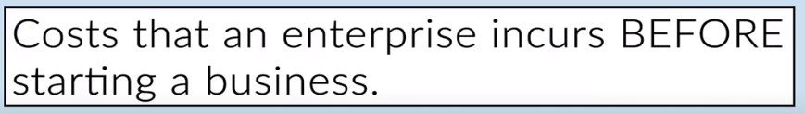
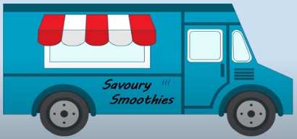
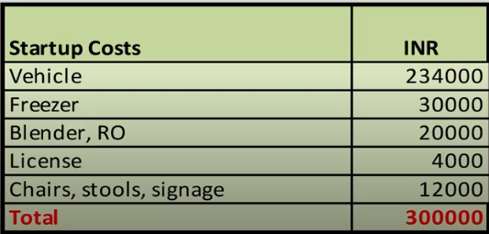
STARTUP COST
Also called as CAPITAL COST
Example

Slide 5
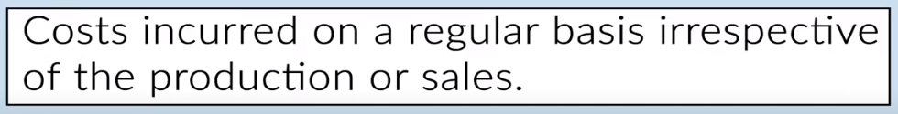
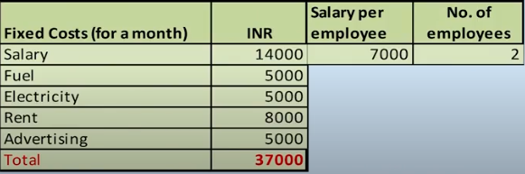
FIXED COST
Usually calculated for a MONTH
Example

Slide 6
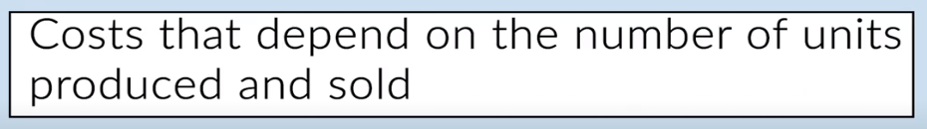
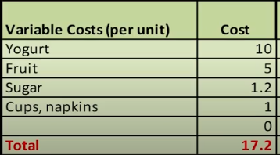
VARIABLE COST
Example

Slide 7

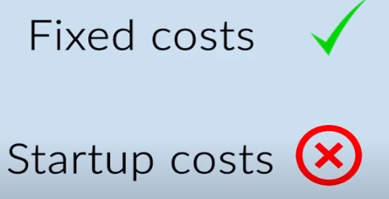

ENTREPRENUER POINT
It is better to have a variable cost than the fixed cost and
Fixed cost than Startup cost
This is to avoid uncertainty in business earnings

Slide 8
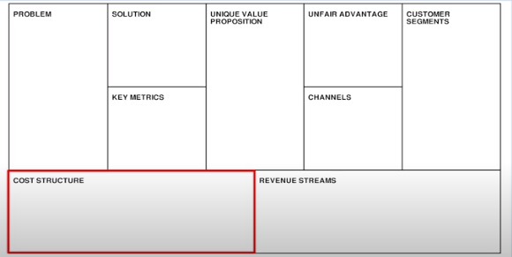



ENTREPRENUER POINT
Obvious for an entrepreneur to identify all cost associated with a business

Slide 9
ENTREPRENUER POINT

Slide 10
BASIC FINANICAL TEMPLATE

Slide 11

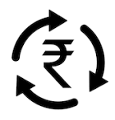
REVENUE STREAMS

Slide 12


REVENUE STREAMS
Revenue ?
One source of income
Home delivery- Another source of income

Slide 13
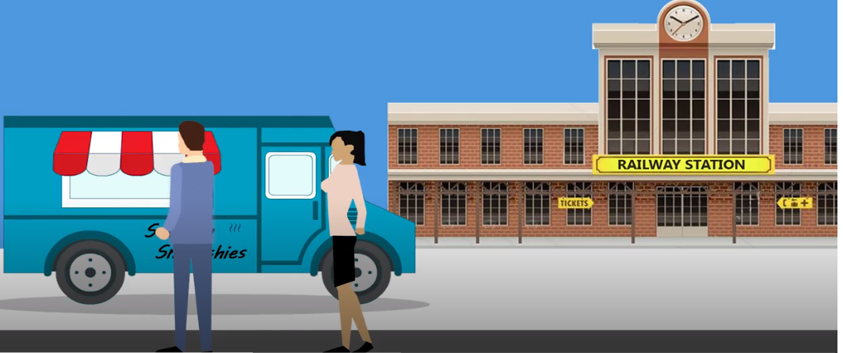
REVENUE STREAMS
Build revenue stream so that you can tap in to the same customer for repeated business – REVENUE DEPENDABLE
NOT a dependable customer
Near an office premises- dependable customer

Slide 14
REVENUE STREAMS
List the sources for revenue streams
Their pricing and
The Life cycle
Evaluate whether the revenue stream is profitable or not
Delivery cost is too high?
But at the later stage when a cheaper delivery option comes up restart the HD
Home delivery- Another source of income
May not be profitable to continue

Slide 15
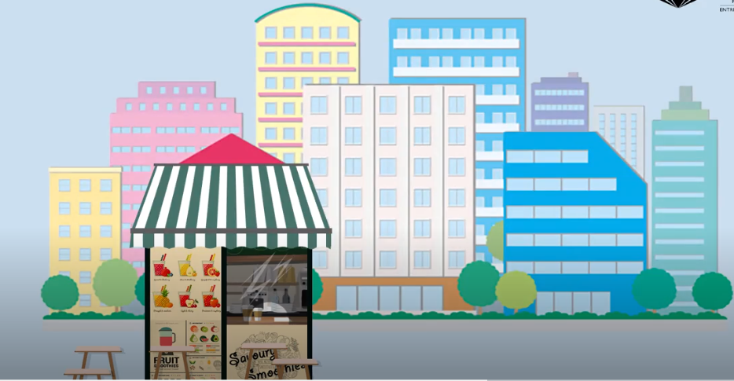
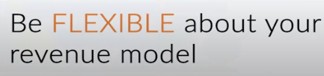
ANOTHER REVENUE STREAMS
Smoothie counter at an office premises

Slide 16
REVENUE STREAM STRATEGY
Constantly look at whether the revenue stream is working for the business
Forecasting and looking at the ways in which permutations of the revenue model will be best.

Slide 17
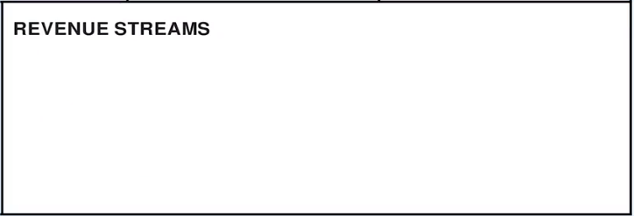


REVENUE STREAM BOX in Lean Canvas
Smoothie example – two sources of possible revenues
Other businesses have different types of revenues – sales, usage fees, etc.

